Slide 1
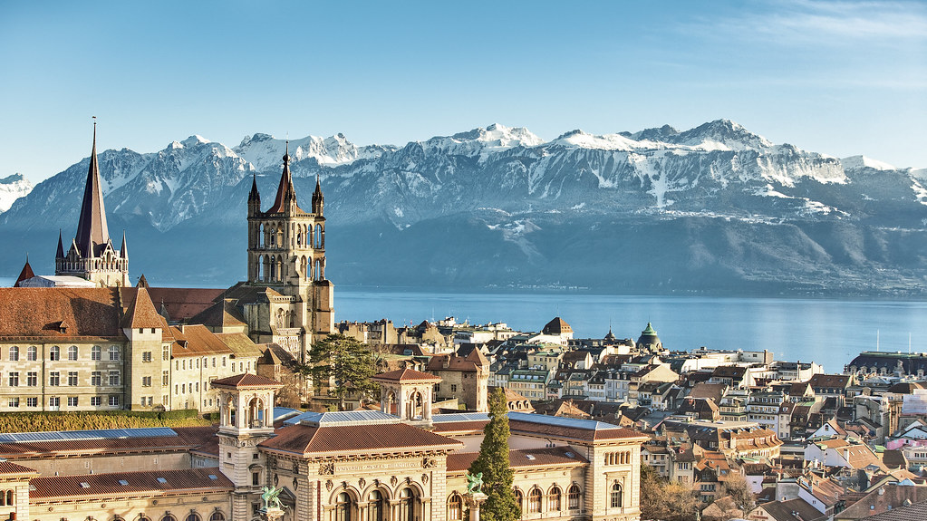


ENVIRONMENTAL QUALITY PLATFORM
FOR HOME-SEEKERS
Adam Swietek
LEURE Prof. Philippe Thalmann
Industry Partnership with Wuest Partner
Focus on Quantifying Price Impact of
Micro-Location/Environmental Factors
🤝
Notes:
I'm interesting in developing a platform that allows home buyers or renter to explore the environmental quality of their neighborhoods. This a natural extension of my on-going industry partnership with wuest who is a real estate consultancy, and they are interested in understanding the influence that these environmental factors have on the real estate decision.

Slide 2

iBuyers, Zillow, and ‘the lemon problem’
-NPR, Planet Money
Companies like Zillow, Opendoor, and Redfin have troves of data on real estate prices
Buy homes using algorithms (AVM) and flip properties
What could go wrong?
Notes:
A good example of why Real Estate Firms like Wuest are interested in this are iBuyers. iBuyers are essentially institution house flippers that use massive amounts of data, some algorithms, to offers home-seller instant cash deals.

Slide 3

After 3 years, Zillow iBuyer fails, cuts 25% of staff and lost $420 million in final Quarter
-NYT, Stephen Gandel, 2021
Not Surprising !
“Why is Intermediating Houses so Difficult? Evidence from iBuyers”, Buchak, Matvos, December 2020
iBuyers’ speedy offers come at the cost of information loss concerning house attributes that are difficult to capture in an algorithm, resulting in adverse selection.
2021
Notes:
But as you may have heard, turned out that Zillow had to shut the program down just after 3 years. A paper had studied iBuyer transactions and pointed out that their model were fairly simple and that were difficult to capture datapoints that Zillow and other do not account which results in adverse selection. If we want to understand what these missing features are, we have to ask would you buy a home without visting the property.

Slide 4

Unstructured Data
Income/Rental agreements
Seller Information
Quality of Amenities
Property Condition
Environmental Quality
Land and View-scape
Notes:
Chances are you wouldn’t, right would want to know what the condition of the property is, how much daylight youll get in the morning, how noisy is the road. Broadly speaking this environmental quality is the impression that a buyer gets, and is one of the most important factors in their decision

Slide 5





Environmental Quality Is Top of Mind
Noise Pollution | Air-Pollution | Daylighting | Thermal Comfort | Visual Quality
Notes:
If we look at the environmental factor independently like air-pollution and visual quality, we can see that quantifying these factors is not-trivial. But thanks to increasing amounts of data and compute its now possible to
And there’s an opportunity for a digital tool to help home buyers and renters digest this information in a convenient way.

Slide 6
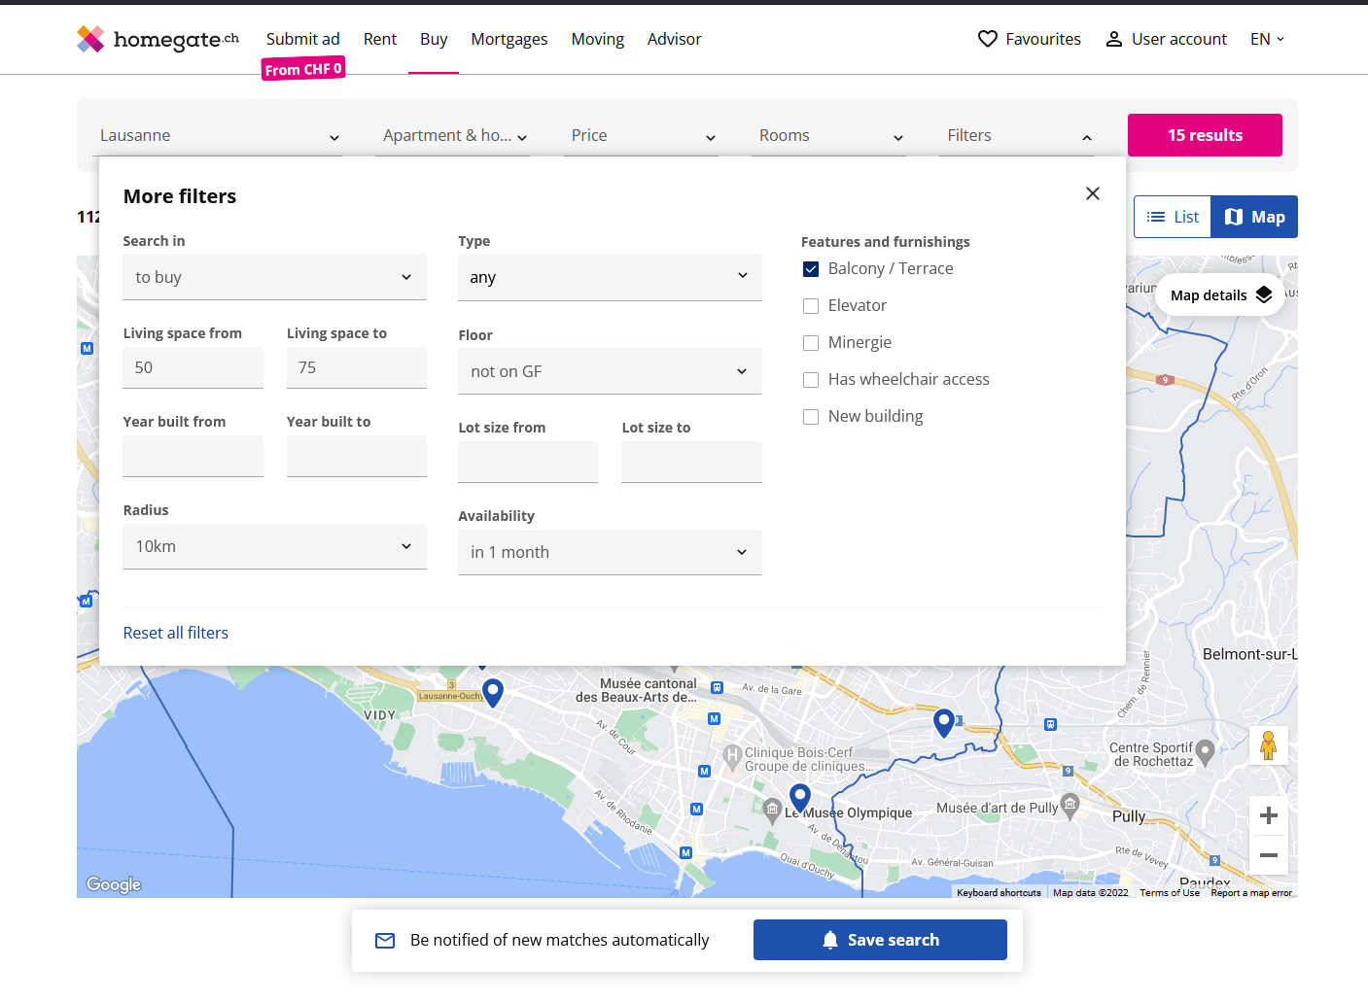
Information is limited to the structure itself
Notes:
So if you were to browse online today for a new apartment– you’ll really only have information on the structure. You can filter by the size, by the age, but if you're interested in any environmental aspect you are limited

Slide 7
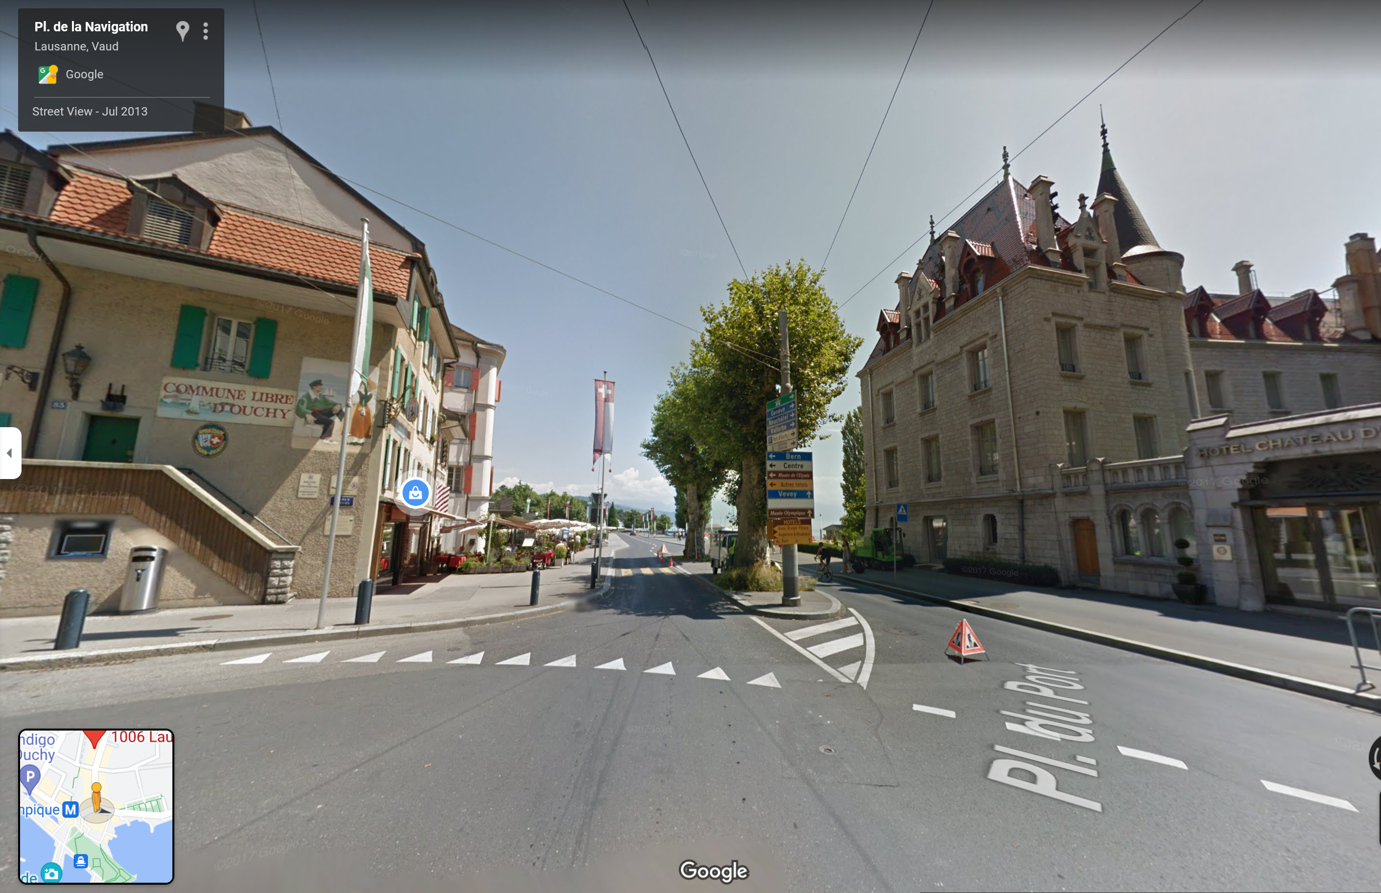
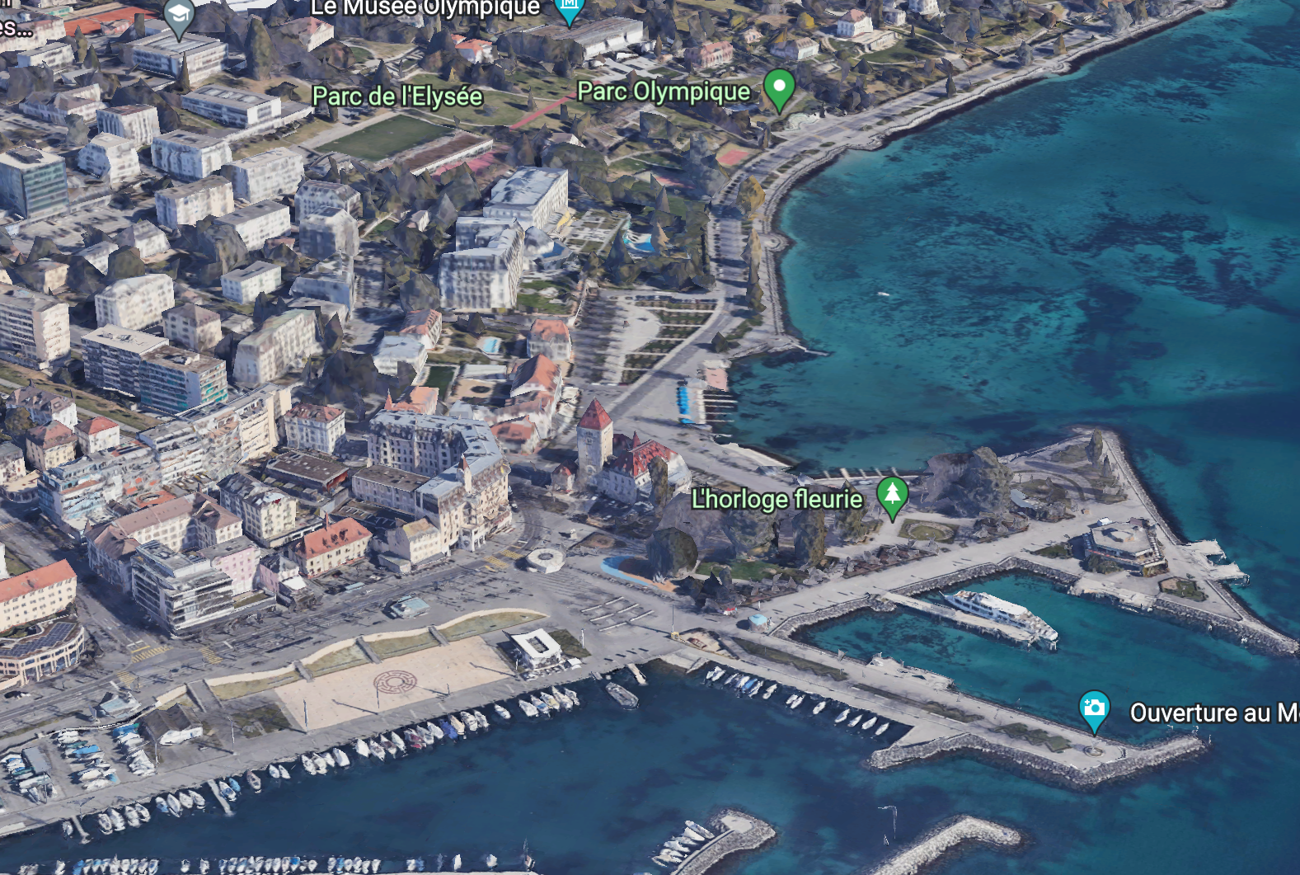
What Other Tools Exist for Home-Seekers?
Google Street View Images & Google Earth
Notes:
You really have google street view, google earth to manual browse and click back and fourth. The photos that the listing offers are often biased not too informative.

Slide 8
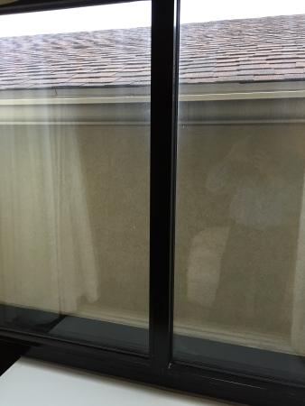

Holiday Inn - Kent State
Four Seasons NYC
Notes:
So in most cases its only when you get to the property do you realize whether you have the view on the left or right.

Slide 9
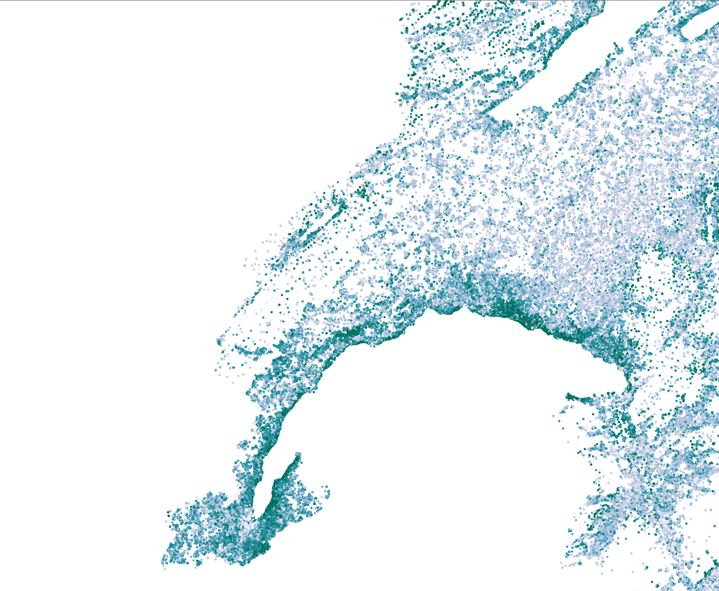
Solution Explore Building-Lvl Data on Environmental Quality
VISUAL QUALITY
Notes:
So the solution I propose to develop is a web application that allow users to explore environmental quality of their neighborhoods and of where they want to live. I will first focus on Visual Quality as this is what my PhD has been focused on with the intent to expand. As part of my industry partnership, I am in a unique position where I have had access to line of sight data for all 3.3 million structures in Switzerland, and have already developed indicators and trained models that quantify the viewscape from a given building. On the right is a visualization of the visual quality ratings produced by my model.

Slide 10
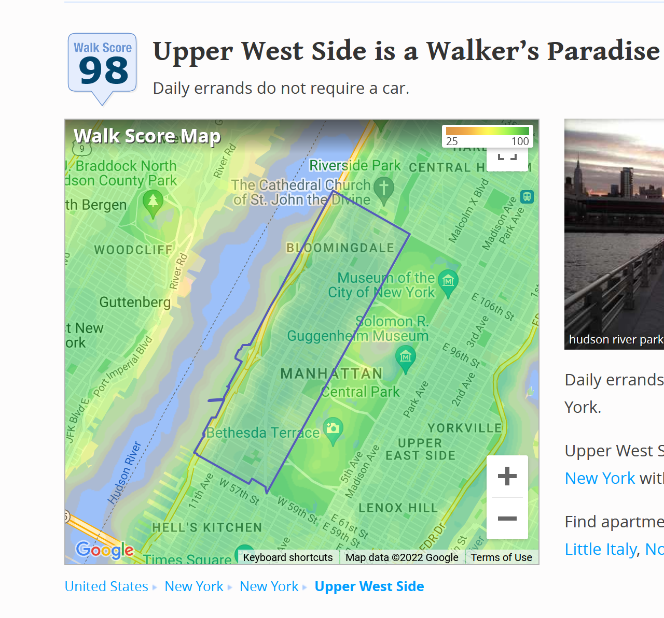
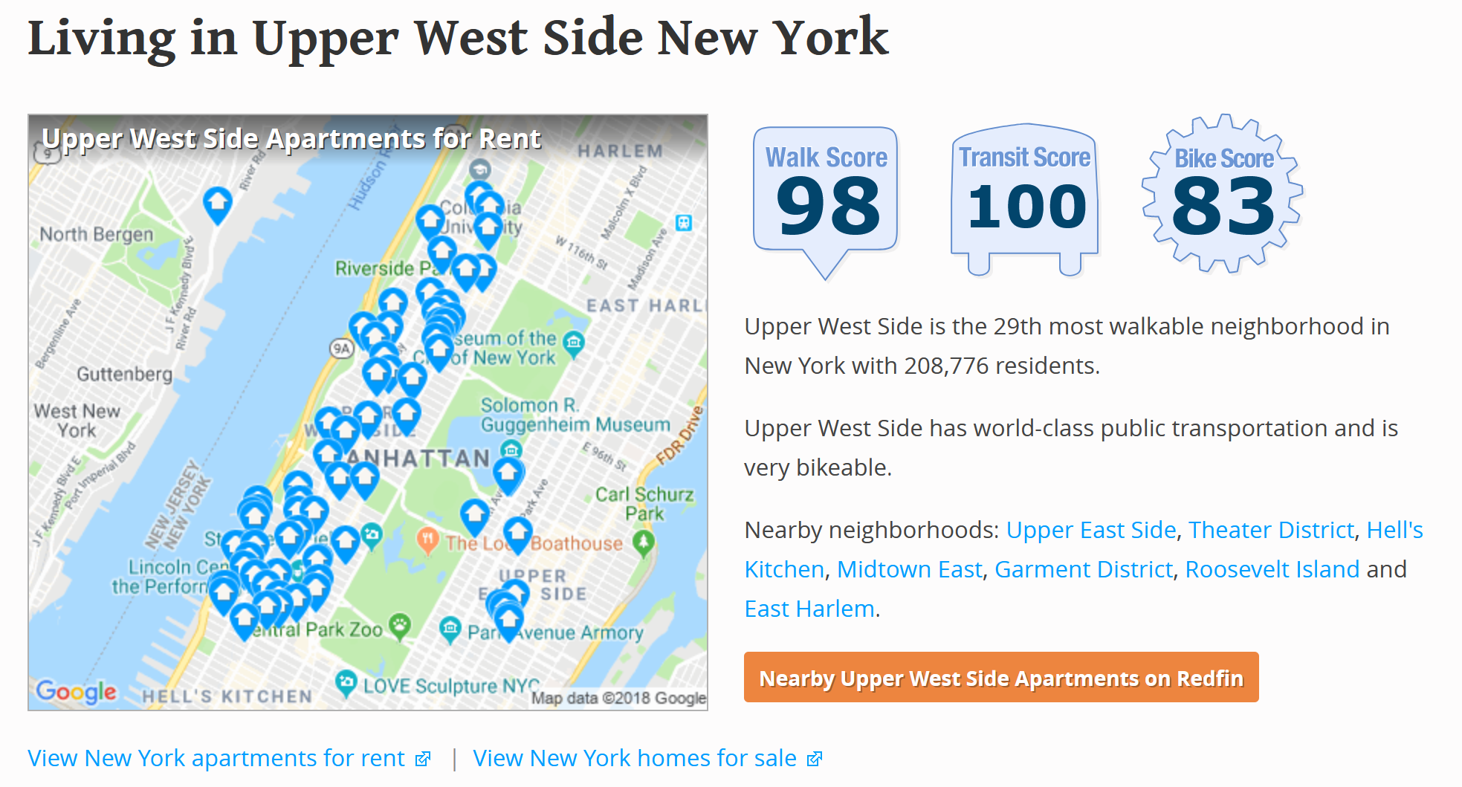
Example: Walk-Score
Notes:
To illustrate what I have in mind- Walk-Score is a close example. You simply type in your location, and you get information on the walkability of a given neighborhood. There business model was really oriented to Real Estate brokers and listing services who use these scores to promote their listing. This information isn’t very useful for European cities, but its quite helpful in the US

Slide 11
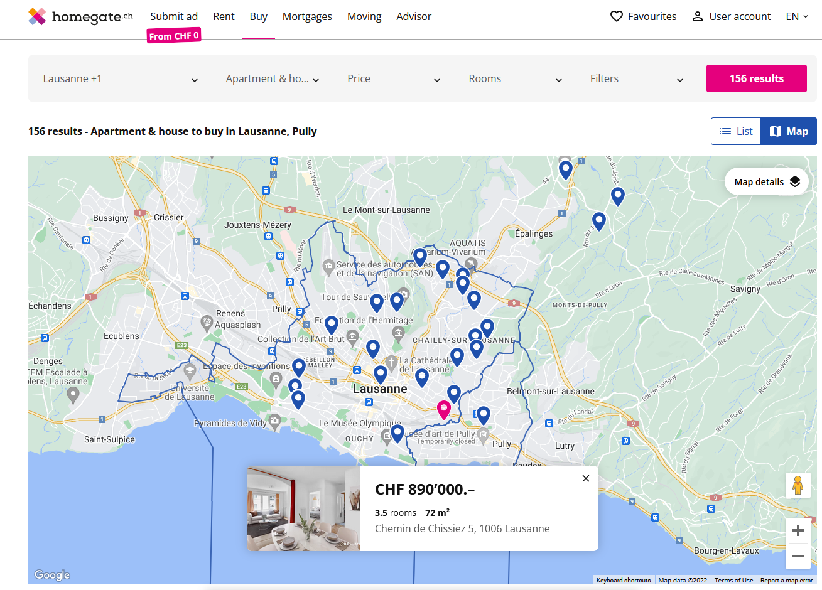
View-Score as a Service for Real Estate listing Service
View-Score
9.2

Slide 12
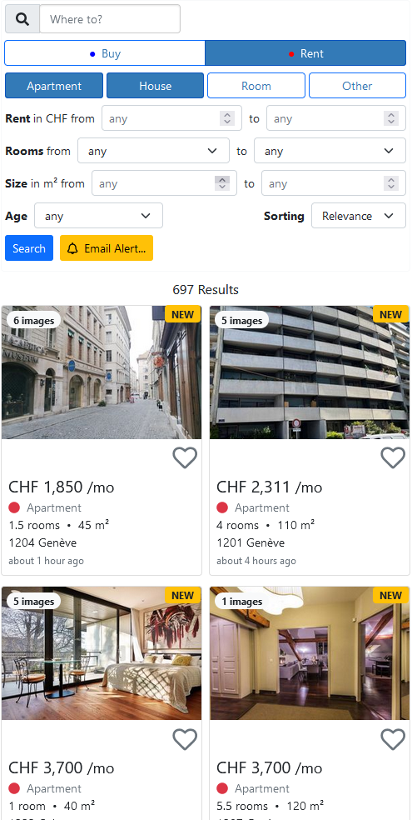
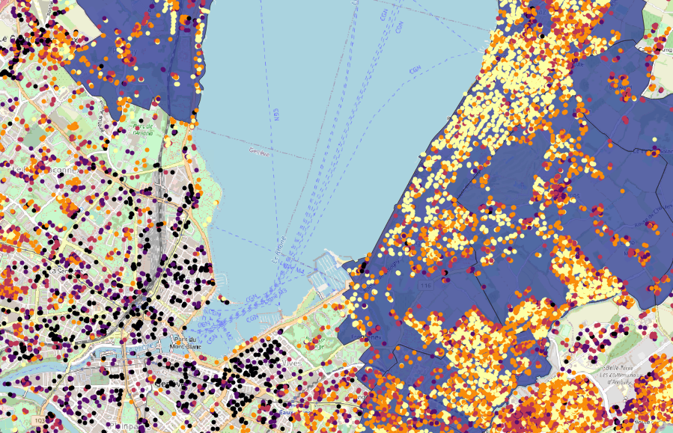
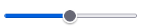
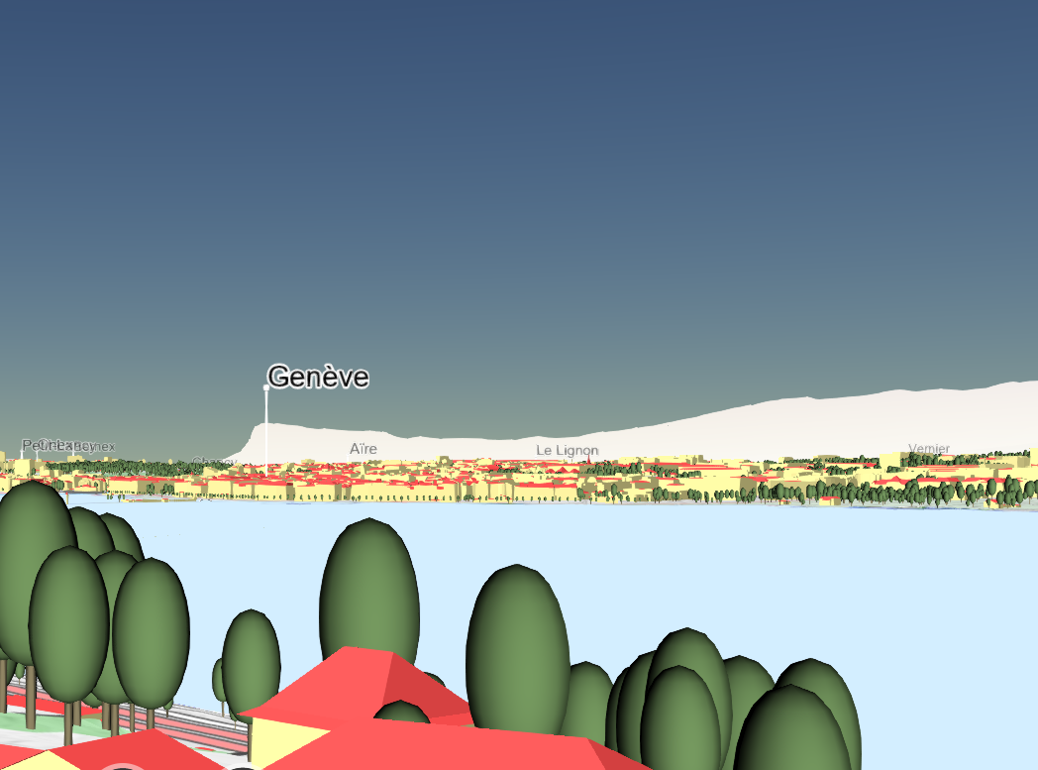
VS as an Exploratory Platform
Active Listing
Geneva
Visual Quality
Lake
Nature
Complexity
Panorama
Daylight
Air Quality

Slide 13
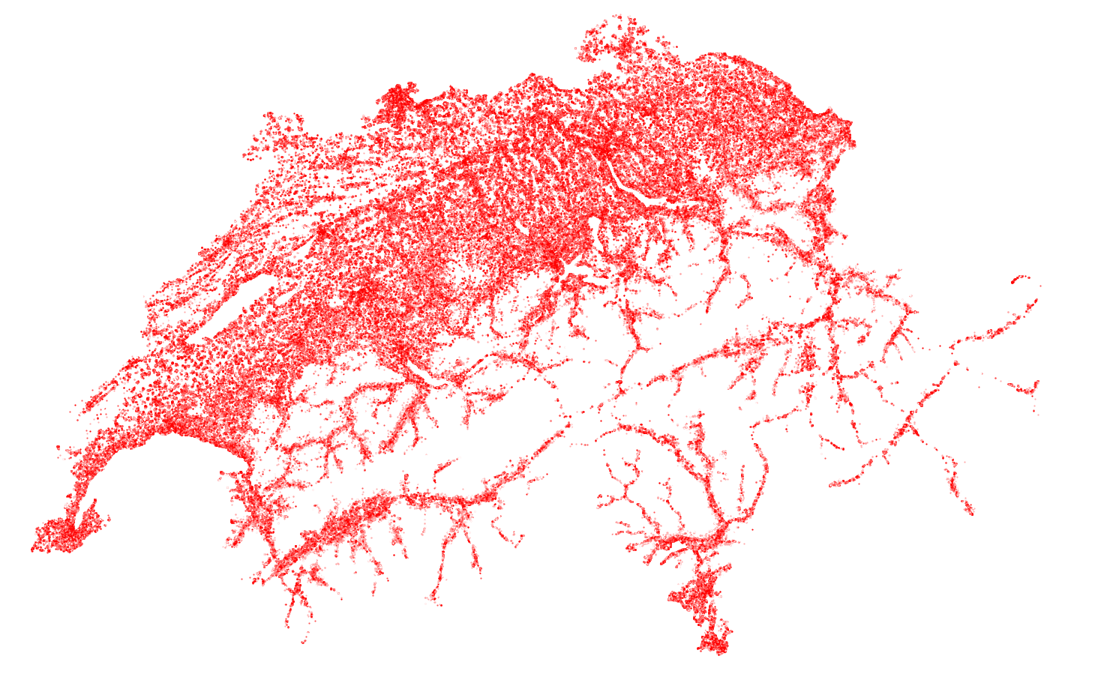
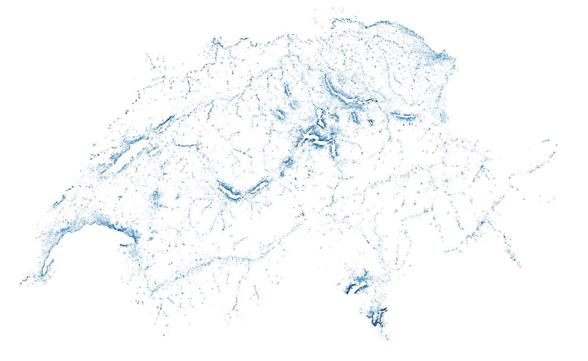
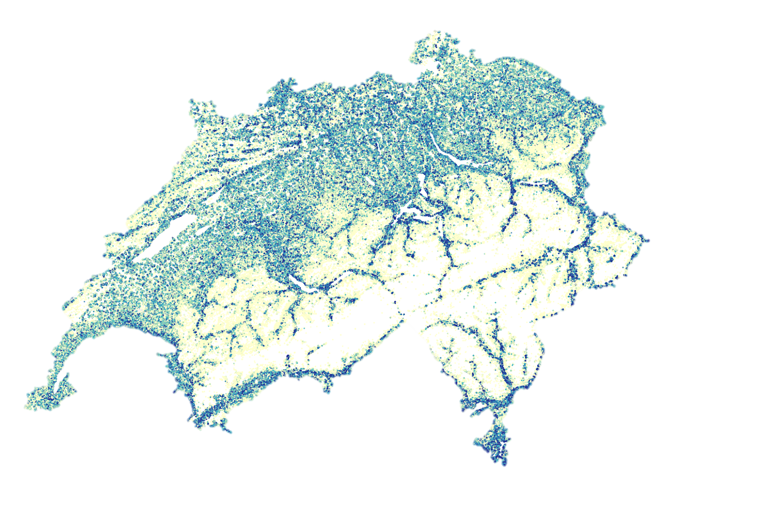
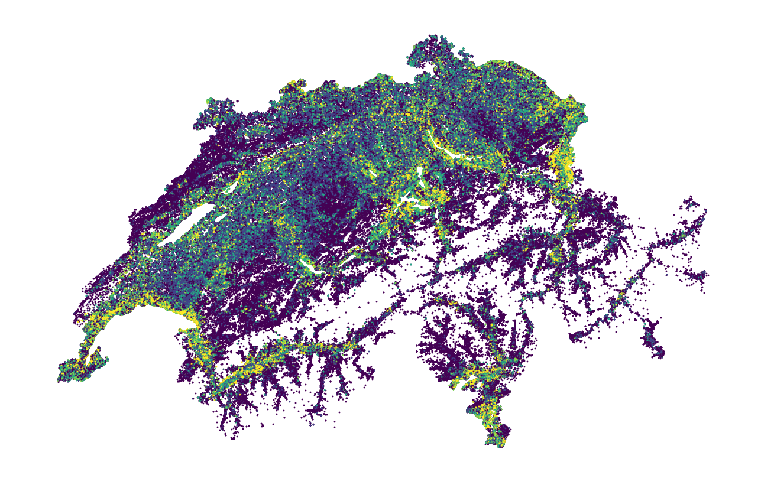
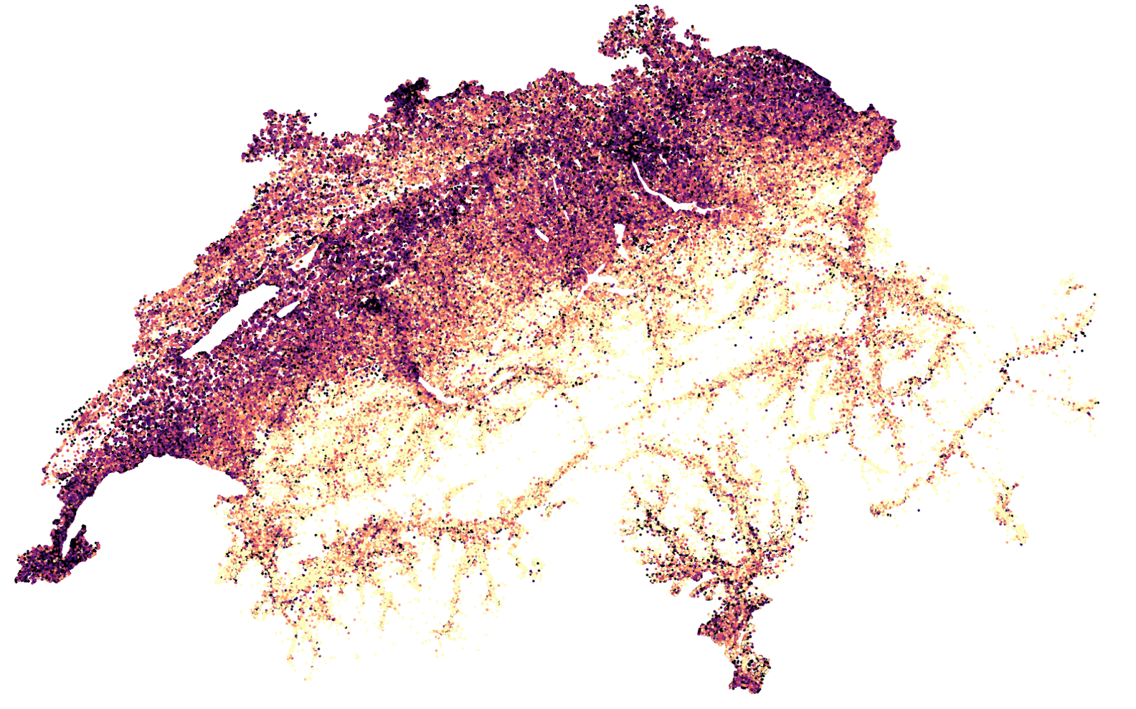
Log % Share of Road View
Log % Share of Lake View
Visual Complexity
Thank
you!
Visual Richness
Visual Panorama
Notes:
Thanks for listening. And I look forward to your questions and suggestions.

